Slide 1

SRM-NIRS-EEG Update 10/13/2023
OOO!!! SPOOKY!!!!

Slide 2
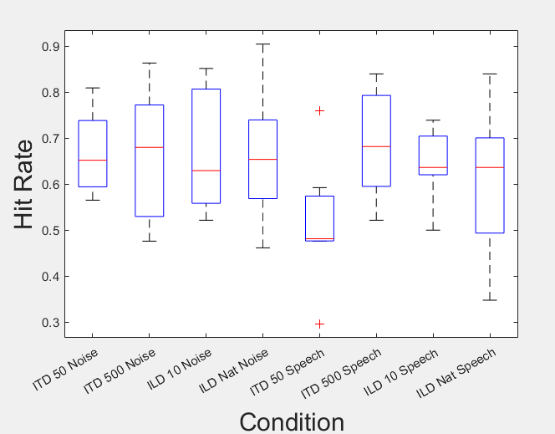
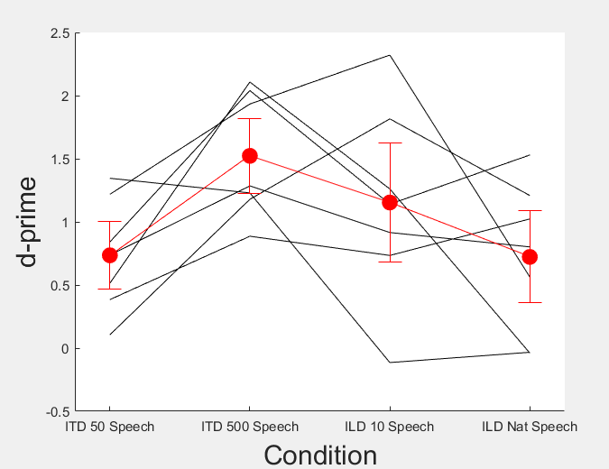
Behavior

Slide 3
NIRS
No stats on these yet I wanna discuss what to do

Slide 6
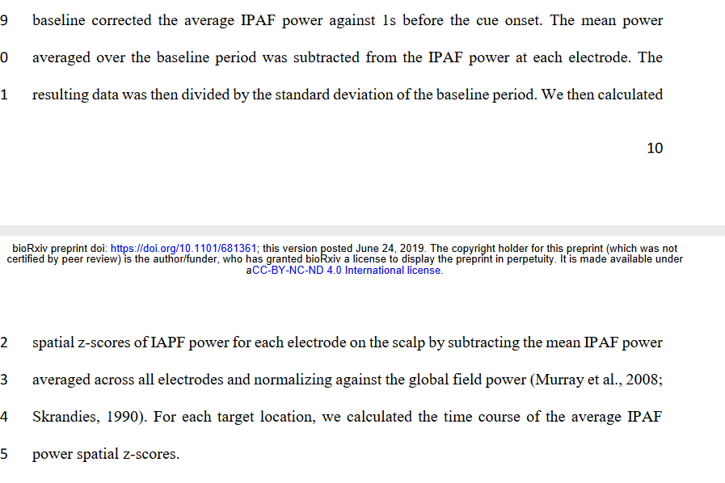
EEG
Current Question: Both Maanasa and I have relatively flat alpha curves. Something to do with global field power, as used in Yuqi’s paper?

Slide 7
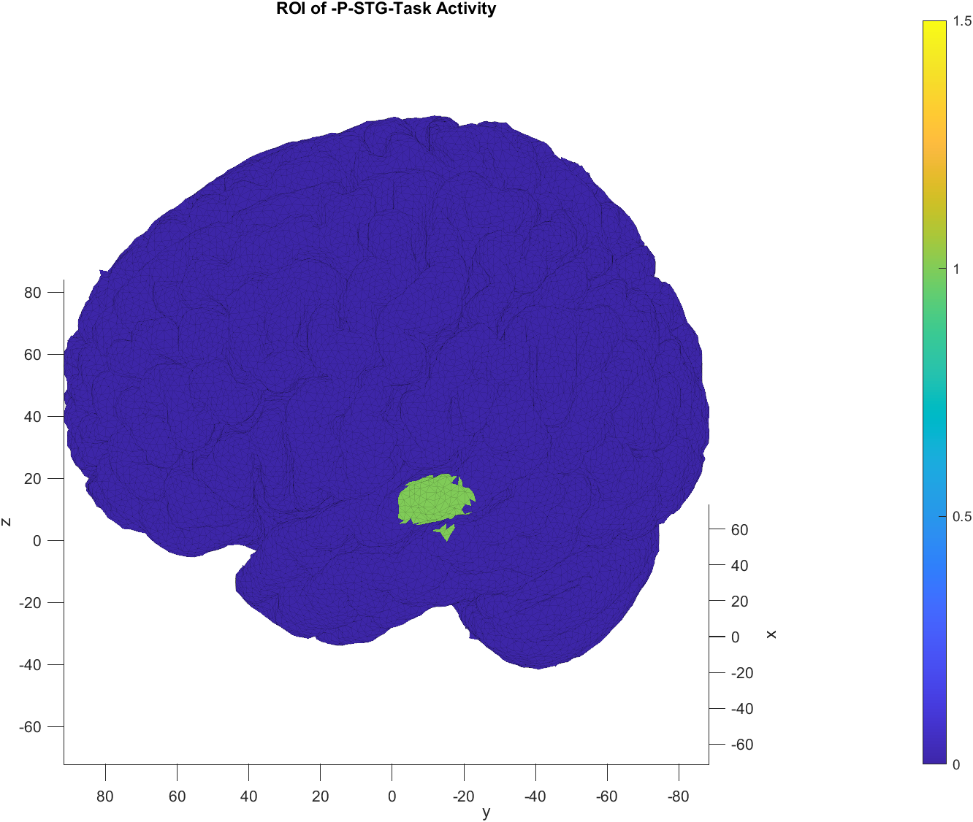
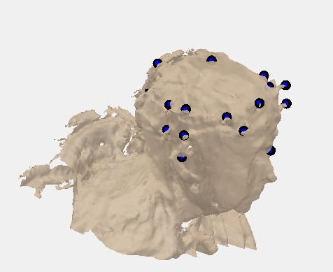
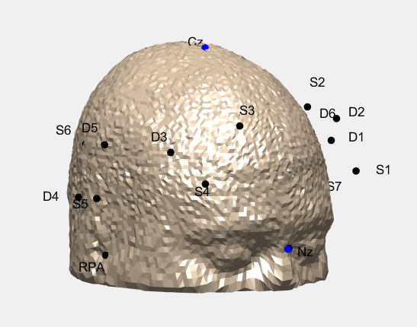
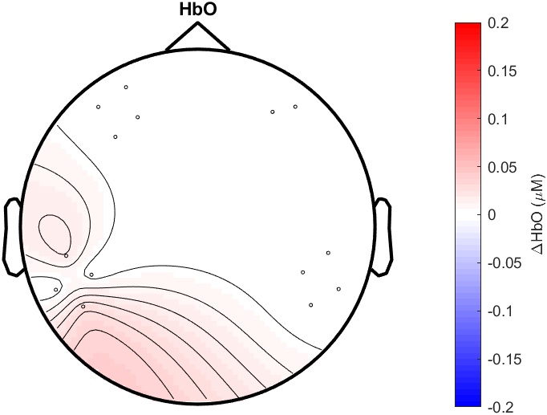
3D Modeling with Eli
This makes sense based on the magnitude of response I get! Comforting I suppose

